Slide 1
Chapter 15 - review

Slide 2
Chapter 15
We looked at the scientists who were instrumental in building the theory of evolution
Jean Baptiste-Lamarck
Charles Darwin
We observed some evidence of evolution we can see today
Homologous, Analagous and Vestigial Structures
Similarities in Embryological development, and macromolecules (DNA and Proteins)
We started to observe some patterns of evolution
Co-evolution
Convergent Evolution
Divergent Evolution
Adaptive Radiation
Artificial Selection

Slide 3
Today
Chapter 15 Review
Build-A-Beast Workshop

Slide 4
REMINDER
N.B. There will be a Chapter 15 Quiz on Tuesday

Slide 5
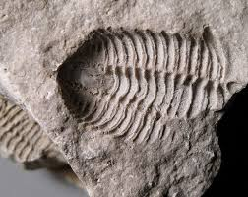
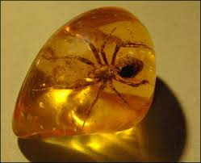
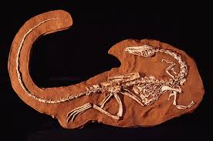
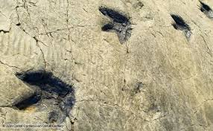
Chapter 15 – Fossils
In your Notebook
Match each type of fossil with the picture
Cast, Mold, Trace, Amber
A
B
C
D

Slide 6
Chapter 15 Review- Fossils
A= Mold Fossil (hollow, un-fllled mold of animal)
B= Amber Fossil (Preserved in sap)
C= Cast Fossil (Three dimensional, filled in structure of once living organism)
D= Trace fossil (a trace that an organism once existed, left behind over time)

Slide 7
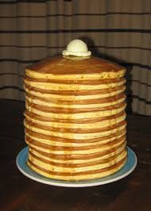
Chapter 15- Fossil Review
In your Notebook
According to The Law of superposition
Which pancake would be the most stale(oldest)?
Which would be freshest (youngest)?

Slide 8
Chapter 15- Fossils
Moving Forward
Know the different types of fossils
Know the law of superposition, and how scientists can use it to use fossils as evidence of the theory of evolution

Slide 9
Chapter 15- Evolutionary Theorists
In your Notebook
Writing Storm (3m)
Write down everything you can remember about the theories of Charles Darwin and Jean Baptiste Lamarck and how they pertained to the theory of Evolution

Slide 10
Theorist
Trait
Jean Baptiste Lamarck
Charles Darwin
Thomas Malthus
Nicolaus Steno
A. Descent with modification
B. Acquired Characteristic
C. Law of super-position
D. Study of Human populations
E. Descent from a common ancestor
F. Modification by Natural Selection
G. Environment molded evolution
H. Species molded evolution

Slide 11
Chapter 15- Theorists
Jean Baptiste Lamarck – A*, B, E, H
Charles Darwin – A, E, F, G
Thomas Malthus – D
Nicolaus Steno – C

Slide 12
Chapter 15- Moving Forward
Note
The contributions made by Jean Baptiste Lamarck and Charles Darwin to the theory of Evolution
Be able to compare and contrast their theories
Know what is meant by Descent with modification, Modification by Natural selection, and evolution by acquired characteristics

Slide 13
Evidence of Evolution (15.3)

Slide 14
Chapter 15- Evidence of Evolution
Pokemon “evolve”
The evidence of Squirtles evolution can be found in the shell of the two different animals that Squirtle is a recent common ancestor with?
What do we call these structures?
What type of evolution are we seeing in action? (Divergent, Convergent, Co-evolution)

Slide 15
The shell of squirtle, wartortle and blastoise are said to be Homologous structures (The are structurally similar, but can serve a different function)
Both Blastoise and Wartortle evolved from a Divergent evolution pattern (Different species arising from a single ancestral species)

Slide 16
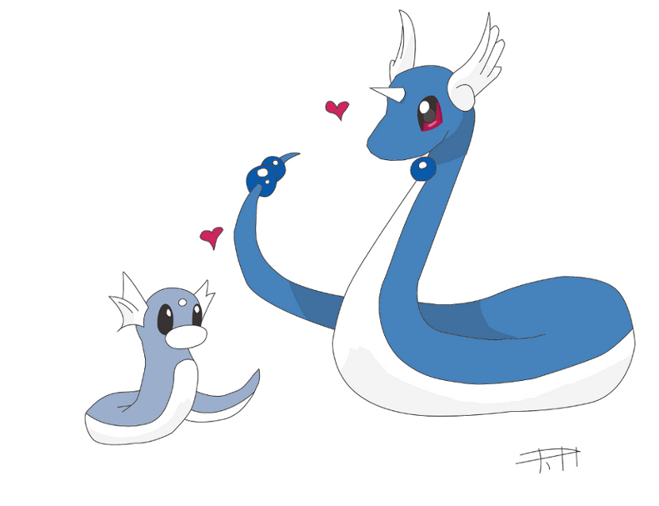
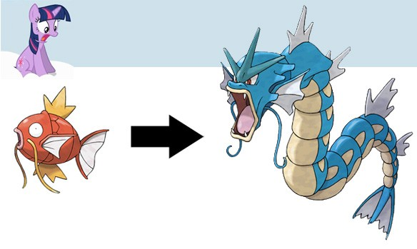
Pokemon evolution cont’d
How do we refer the structural similarities between Gyardos and Dragonair? What is this pattern of Evolution?

Slide 17
Pokemon Evolution
The snake like body structure between Gyardos and Dragonair are said to be Analogous Features (Similar in structure and function, but evolved from different ancestors)
This pattern of evolution is referred to as Convergent. Different species evolving similar characteristics due to environmental pressures and resource availability.

Slide 18
Vesitigial Features
What is a vestigial feature?
Apparently useless structure. However it provides evidence that a common ancestor or currently living organism used that structure, and provides evidence of ancestry between those organisms and the modern organism that has the vestigial structure
What are some vestigial structures we can think of?
Human appendix, Pelvic bone of snakes and whale

Slide 19
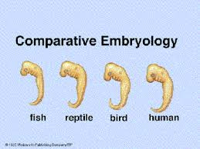
Other things to keep in Mind
Similarities in Embryology

Slide 20
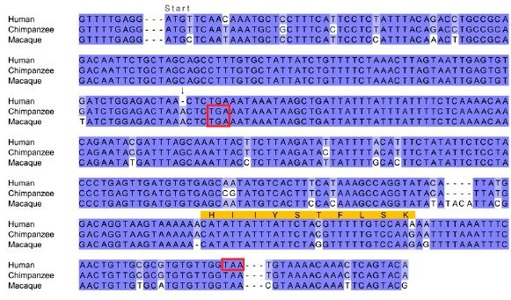
Similarities in Macromolecules

Slide 21
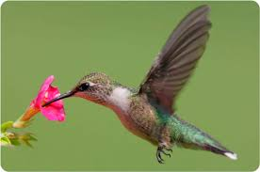
Co-Evolution

Slide 22
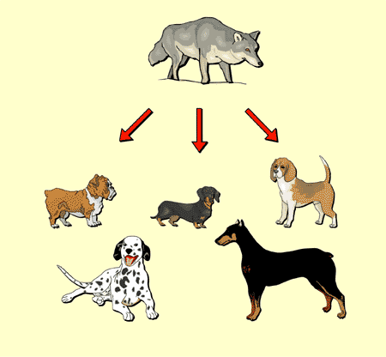
Artificial Selection

Slide 23
Chapter 15 Review
15.3
Know the different structural evidences of evolution and how they provide evidence of common ancestry
Homologous, analogous, vestigial, macromolecule and embryological
Recognize the different patterns of evolution
Divergent (adaptive radiation, artificial selection), Convergent, Co-Evolution

Slide 24
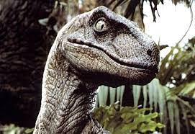
Time to Build a Beast!
In your research groups…
Grab 1 Build a beast work sheet, and one Environmental change
In your groups, take the environmental change and the handout to build a new species out of your existing one
ST

