Slide 1
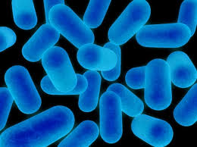
Welcome to Biology 11
Mr.Hill

Slide 2
My Goal For This Course:
My goal as a teacher in this course is for each of you to feel personal success in Biology, as well as developing useful skills of collaboration, critical thinking and work ethic for your futures!

Slide 3
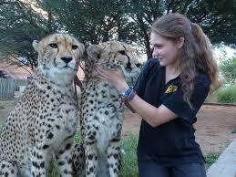
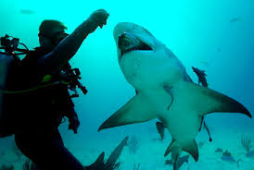
Welcome, Biologists!
Taking Biology 11 is the very first step Doctors, Scientists, Geneticists, Marine Biologists etc. take in pursuit of their future careers!
This class is a lab based course. By taking this class, you are stepping into the role of a “Biologist”
1. Think: How must I conduct myself in this classroom, similar to a Biologist in their laboratory/field?

Slide 4
2a. Pair Up
2b. Group Up
Discuss Ideas In terms of how biologists conduct themselves at work
Examples:
Behavior
Punctuality
Professionalism
Etc.
Come up with ~3-4 ideas (Write on White Boards)
Join another pair
Discuss the ideas/thoughts that you have come up with
Pick the top ideas between the group

Slide 5
3. Share
Each Group of 4 will share out their best Idea with the class and post them up on the White Board

Slide 6
2 Rules I Would Like to Add…
Technology In the Classroom
Technology is a branch of science, and an amazing tool which has advanced and connected us in many ways.
However, texting “Susie” or “Jimmy” while Mr.Hill or one of your peers is talking does not necessarily advance our world, or our learning, in the same way
During free work time, personal device use is encouraged, as long as it is being used responsibly for the task at hand.
Food and Drink
Water will be permitted, but ingesting other food/drink may be a safety hazard while working in a laboratory environment.

Slide 7
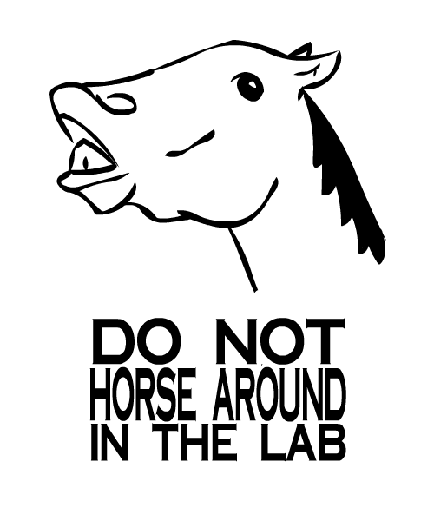
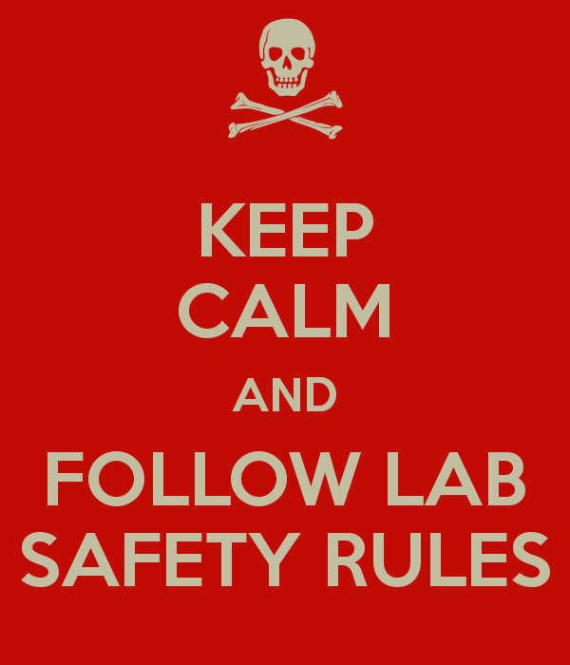
LAB SAFETY

Slide 8
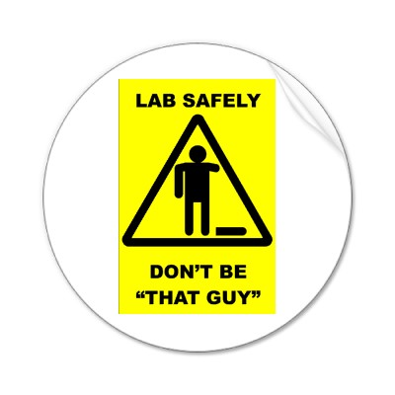
Safety Precautions
General
Always read and review lab manual before starting an experiment
Never touch chemicals with hands, taste or inhale
Wear Safety Goggles
ALWAYS WASH YOUR HANDS FOLLOWING LABS
Know Location of Emergency Supplies
B) Sharp Instruments
Use Scissors instead of scalpel when applicable
Never dissect a hand-held specimen
Only use 1 edge razor blades

Slide 9
Safety Precautions Cont…
C) Glassware
Discard broken or chipped glassware in appropriate bin
D) Heating Materials
Use only heat resistant glassware
Never directly touch hot glassware!
Keep hair and any loose clothing away from open flame

Slide 10
Back to the Biology
What is Biology?
Biology literally means the “Study of Life” (Greek- Bios= life, logia= study of)
Biologists attempt to explain how living things:
Grow
Reproduce
Use Energy
Respond to their environment

Slide 11
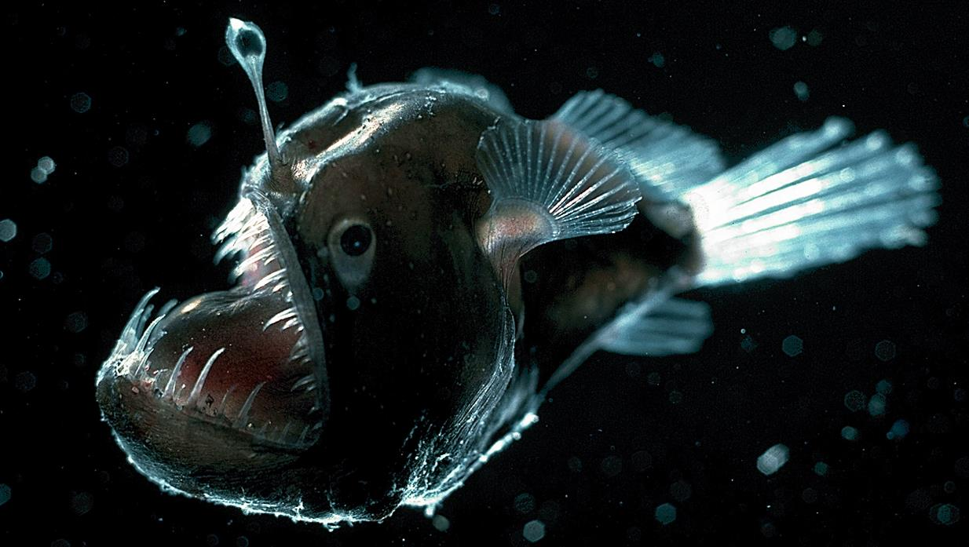
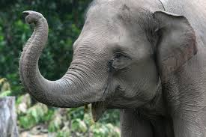
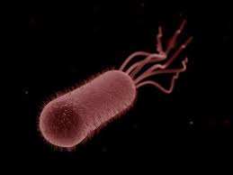
Basic Concepts of Biology
Unity and Diversity of Organisms
There is a wide variety of living things (Diversity)
However, all living things share certain characteristics (Unity)
E.g. Growth, Reproduction, Need for Energy

Slide 12
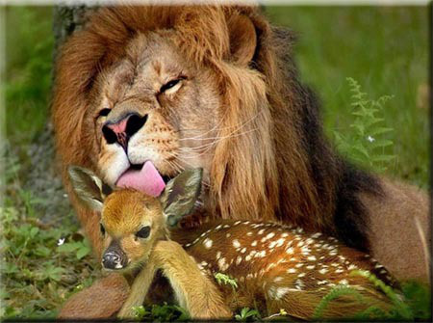
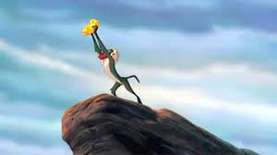
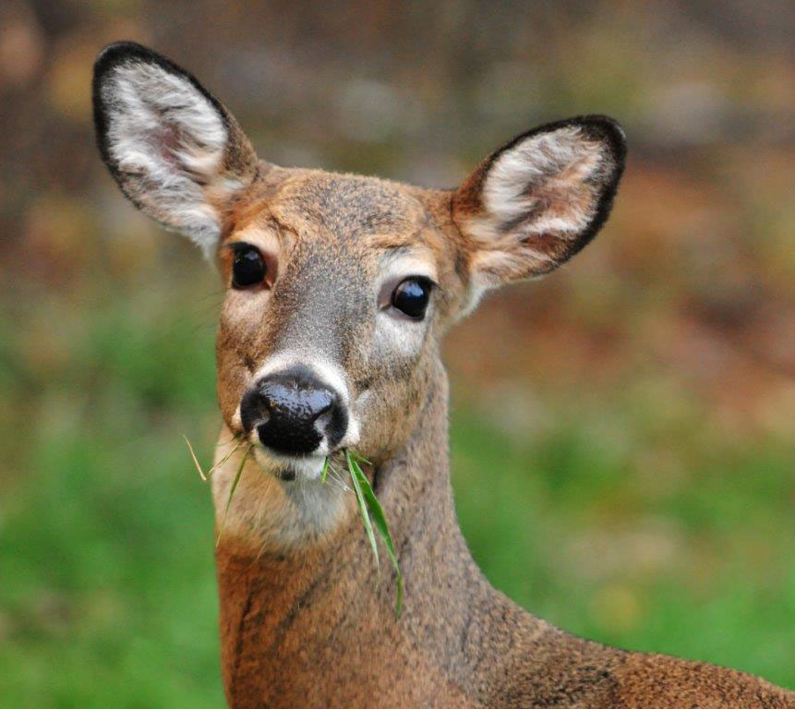
Basic Concepts of Biology
2. Interactions
All Living things are affected by, and affect, all of the things around them
Interact with members of the same species, different species and factors in the environment

Slide 13
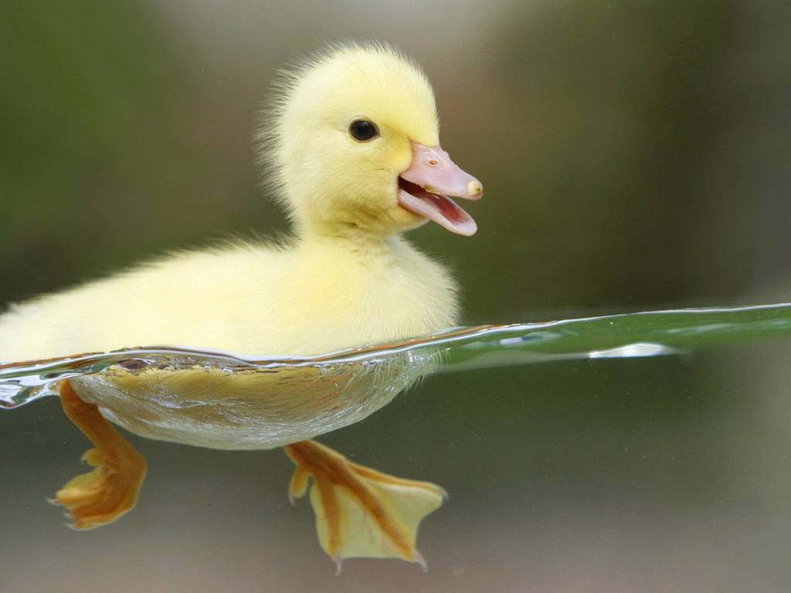
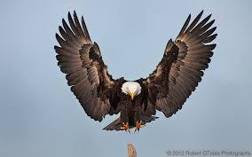
Basic Concepts of Biology
3. Structure and Function
Organisms have different structures depending on their role in their environment
E.g. The sharp beak and talons of Eagles v. the bill and webbed feet of Ducks
Organisms most suited for their roles will likely survive and reproduce.
This is the Basis of Natural Selection, the cornerstone of Evolution

Slide 14
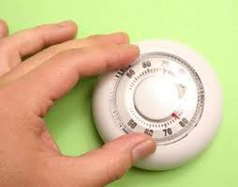
Basic Concepts of Biology
4. Continuity
All living things die, but successful organisms are able to pass their genes onto the next generation
5. Homeostasis
Maintaining internal balance allows organisms to survive temporary changes to the environment
Our “Internal thermostat”

Slide 15
BIOLOGY QUESTIONNAIRE
Please use this time to fill out the Biology questionnaire in front of you. This will allow me to get a better feel for the type of person/student you are, as well as allow me to see what areas of interest you would like to explore this year in Biology!

Slide 16
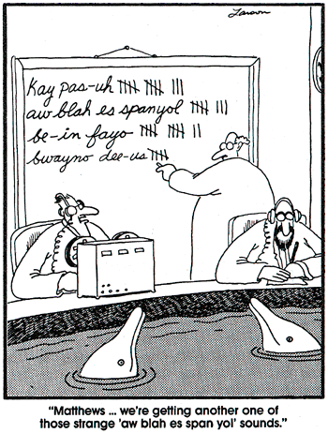
The Scientific Method
Organizing the way that we perform studies in Science!

Slide 17
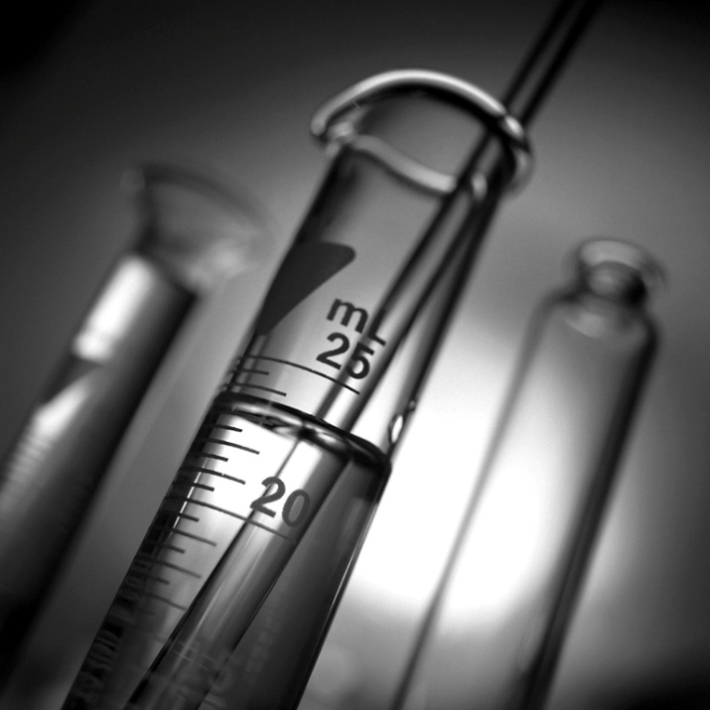
What is Science?
Science observes and looks at the processes that occur in the natural world.
These observations can change if new information arises from new investigations.

Slide 18
Theory:
When many scientists get the same findings over and over again, their concept becomes a theory.
A theory can never be said to be true – it can only be said to be supported by data and evidence.

Slide 19
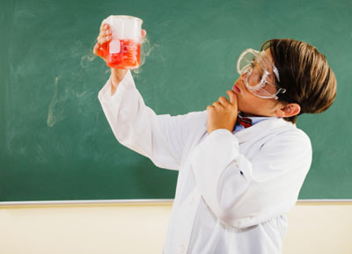
SCIENTIFIC METHOD:
a way to ask and answer scientific questions by making observations and doing experiments.

Slide 20
The steps of the scientific method are to:
Ask a Question
Do Background Research
Construct a Hypothesis
Test Your Hypothesis by Doing an Experiment
Analyze Your Data and Draw a Conclusion
Communicate Your Results

Slide 21
Hypothesis:
A hypothesis is a tentative, educated explanation of your observations.
Usually an IF…THEN statement
Example: Assume you are collecting bacteria on 2 agar plates that you have collected from different areas around the school, and you notice there is a significant difference between one plate in the cooled fumehood, and your other plate on the table. The one on the table has significantly more bacteria on it than your other plate.
Fumehood
Table

Slide 22
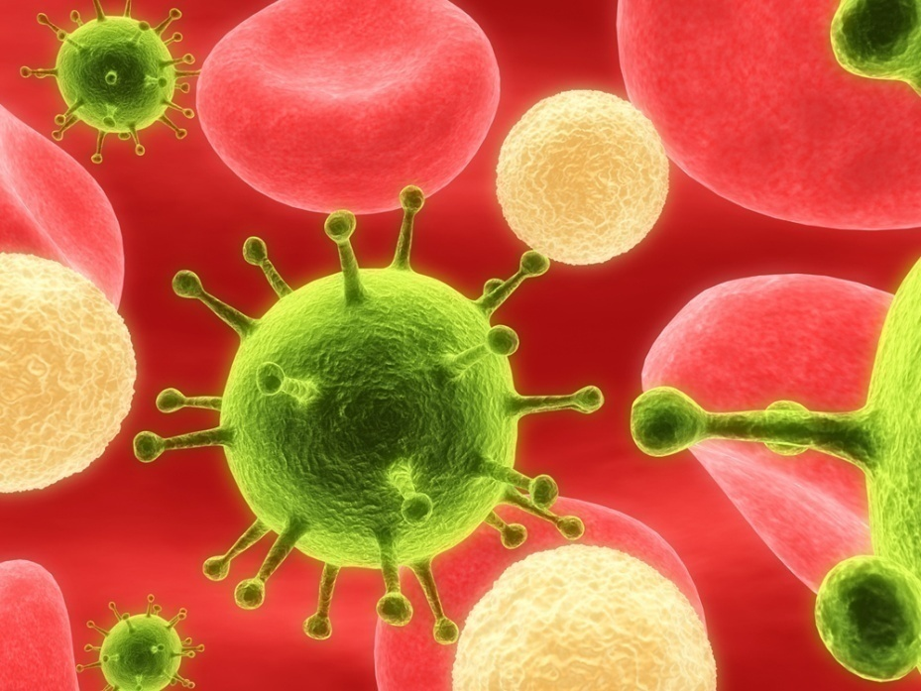
Following the Scientific Method
Observation: there is something that causes bacterial growth to increase, you just aren’t sure what it is.

Slide 23
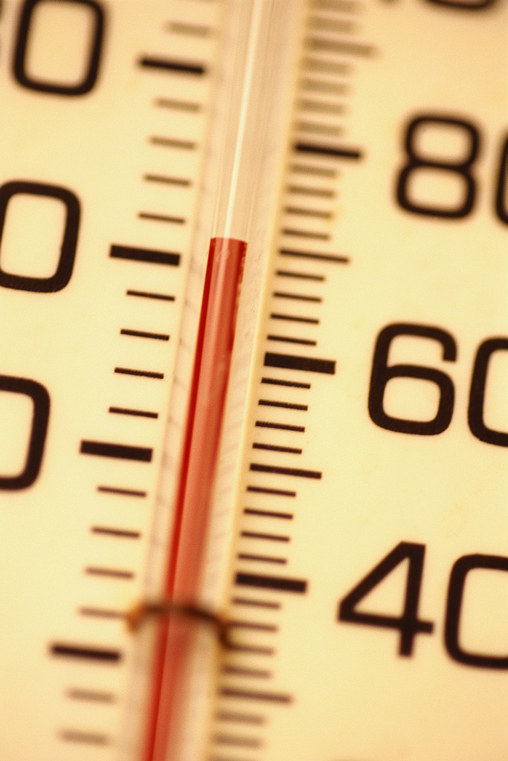
Following the Scientific Method
Research the Problem/Make a Prediction: Does changing temperature result in a change in bacterial growth? Maybe the hotter it is, the more bacteria will grow?.

Slide 24
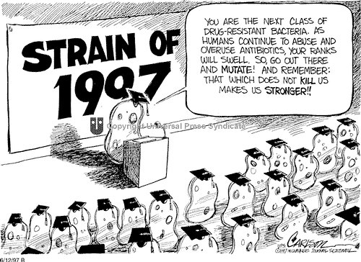
Following the Scientific Method
Form a hypothesis: IF the temperature of a bacterial culture is raised by 5˚C, THEN the bacteria will grow faster

Slide 25
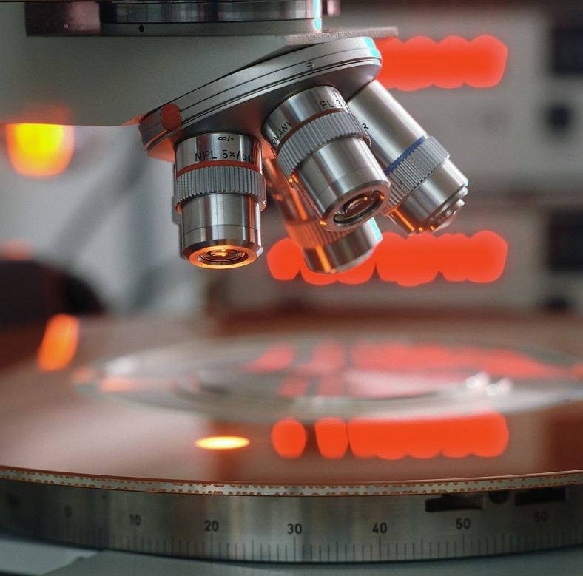
Following the Scientific Method
Experiment: You need to design a VALID experiment that gives you lots of data to work with (collection of facts)

Slide 26
How do you make a valid experiment?
In order to be valid, an experiment must be:
Repeatable (i.e. replicable): If you, or someone else, can’t duplicate the experiment exactly… how do you know you were right? Others have to be able to repeat the experiment and see if they get the same results—if they do, chances are you might be onto something! ☺

Slide 27
How do you make a valid experiment?
Controlled: The experiment must be structured and conducted systematically so that it is crystal clear what factors caused the results. For that reason we do not test just one bacterial culture, we test many!

Slide 28
Variables:
When we test the cultures, we change the experimental variable, but do not change the controlled variables.
Experimental variable: condition which is changed by the scientist to see its effect
Controlled variable: condition(s) which is left unchanged for comparison Note: only one variable is experimental--- e.g. light, location, care, etc… everything is the same except higher temperature. If they are not the same, you aren’t sure what caused the result! ☹

Slide 29
Variables:
In a valid and controlled experiment, always make sure you have at least one control group!
Back to the experiment! The bacteria are collected and plated the same way, the same amount, the same type of bacteria and all conditions were kept the same for all Petri dishes (controlled variables), except the experimental variable (temperature) was changed.

Slide 30
Back to the Experiment!
Bacteria 1:
20˚C
Bacteria 1:
30˚C
Bacteria 1:
40˚C
No bacteria Added
Bacteria 1:
25˚C
Bacteria 1:
35˚C
What do you notice in general terms about the colonies of bacteria as temperature goes up?
What is one explanation as to why there are no bacteria at 40˚C?

Slide 31
5) Now let’s analyze the results: Let’s present it graphically ☺
No. of bacterial colonies
Temperature (˚C)

Slide 32
6) Make a Conclusion
We can conclude that increasing temperature increases bacterial growth of bacteria 1. However, if the temperature is raised between 35-40˚C, the bacterial growth ceases.
Possible experiments to further understand this phenomenon of bacterial growth???

Slide 33
To Do Now…
5 minute experiment Think of a question, any question and expand on your question using the scientific method. Formulate a hypothesis, conduct an experiment, analyze the results, write out a conclusion. E.g. Does crumpled paper fall faster to the ground than folded paper? What is the most popular color of shirt in this class? Get creative, but don’t forget the fundamentals of Lab Safety which we have just discussed! Submit your conclusions and results to Mr.Hill

Slide 34
Question: Prior Knowledge/Research: Hypothesis: Steps in Exp.: Results: Conclusion:

